Slide 1

GENG-8900 MACHINE LEARNING
Instructor: Dr. Yasser Alginahi
Dimensionality reduction:
Linear Discriminant Analysis
Shashank Prakash Naidu | 110090086
Tejus Vivek | 110095845
Mahenur Patel | 110120170
Date: 17-Nov-2023

Slide 2
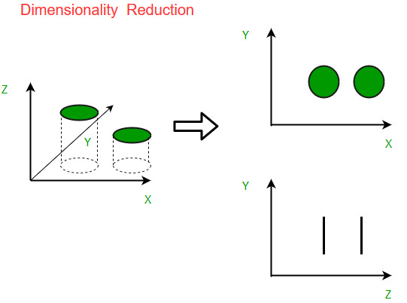
What is Dimensionality Reduction?
Dimensionality reduction is a technique used to reduce the number of features in a dataset while retaining as much of the important information as possible.[1]
High- Dimensional data Large Number of Variables / Features
Fig.1 Components of Dimensionality Reduction
[https://tinyurl.com/5n6k7r2e]
There are two main approaches to dimensionality reduction:
Feature selection
Feature extraction.

Slide 3
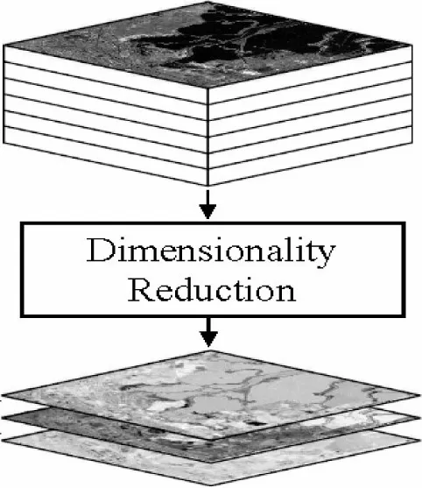
Why Dimensionality Reduction?
High-dimensional data poses challenges in analysis and interpretation.
Dimensionality reduction enhances computational efficiency and aids in visualization.
We'll explore the motivations behind the need for techniques like LDA.
Example: Think about a dataset tracking customer behavior on an e-commerce platform.
Original Dataset: customers' age, browsing history, purchase frequency, and more.
Fig.2 Dimensionality Reduction
[https://tinyurl.com/3mx28kj7]
After Dimensionality Reduction: essential patterns in customer behavior.
3

Slide 4
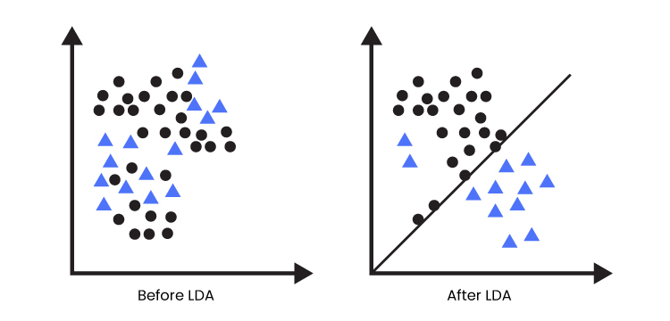
What is Linear Discriminant Analysis?
Linear Discriminant Analysis (LDA) is a supervised learning algorithm used for classification tasks in machine learning. It is a technique used to find a linear combination of features that best separates the classes in a dataset.[2]
Higher Dimensional Space(Data) LDA Lower Dimensional Space(Data)
Two criteria are used by LDA to create a new axis (Lower Dimensional Space):
Maximize the distance between means of the two classes.
Minimize the variation within each class.
Fig3. Classification of various objects before and after implementing LDA
(https://tinyurl.com/23ywuc56)

Slide 5


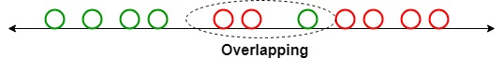
Overlapping in Linear Discriminant Analysis (LDA)
Example: Apple and Tomato
In this case, there are two classes, and we must effectively divide them. Classes can have several features. As the image below illustrates, there may be some overlap if you try to categorize them using only one feature.
2.4mg | Fiber | 1.2gm
54 IU | Vitamin A | 833 IU
5mg | Magnesium | 11mg
Table1.Features of Apple and Tomato (https://tinyurl.com/4vp5b7s6)
Overlapping (https://tinyurl.com/66snrywh)

Slide 6
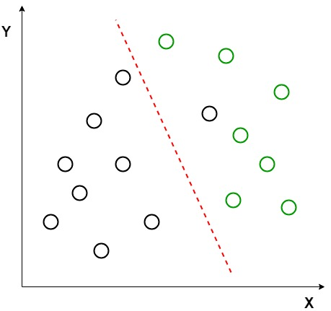


Better Understanding in Linear Discriminant Analysis (LDA)
Two sets of data points belonging to two different classes.
Data points are plotted on 2D plane.
No straight line can be seen.
LDA uses both X and Y axis to create a new axis.
LDA is used to reduce to 2D graph to 1D graph.
Data set Apple
Fig4. Representation of two sets of data points(https://tinyurl.com/66snrywh)
Data set B Tomato

Slide 7
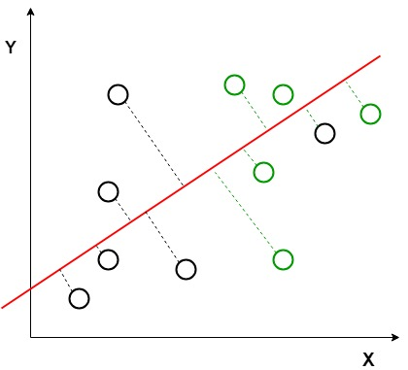
Better Understanding in Linear Discriminant Analysis (LDA) (Contd…)
Two criteria are used by LDA to create a new axis:
Maximize the distance between means of the two classes.
Minimize the variation within each class.
Red line indicates the new axis that has been generated.
The generated axis increases the separation between the data points of the two classes.
Fig5. Data points after LDA (https://tinyurl.com/66snrywh)

Slide 8
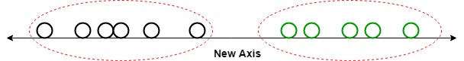
Better Understanding in Linear Discriminant Analysis (LDA) (Contd…)
All the data points of the classes are plotted on this new axis and are shown in the fig6. given below. .
Fig6. Data points on 1D graph after LDA(https://tinyurl.com/66snrywh)
When the distribution means are similar, LDA is unable to identify a new axis that would allow both classes to be linearly separable, so the analysis is deemed ineffective. We apply non-linear discriminant analysis in these situations.

Slide 9
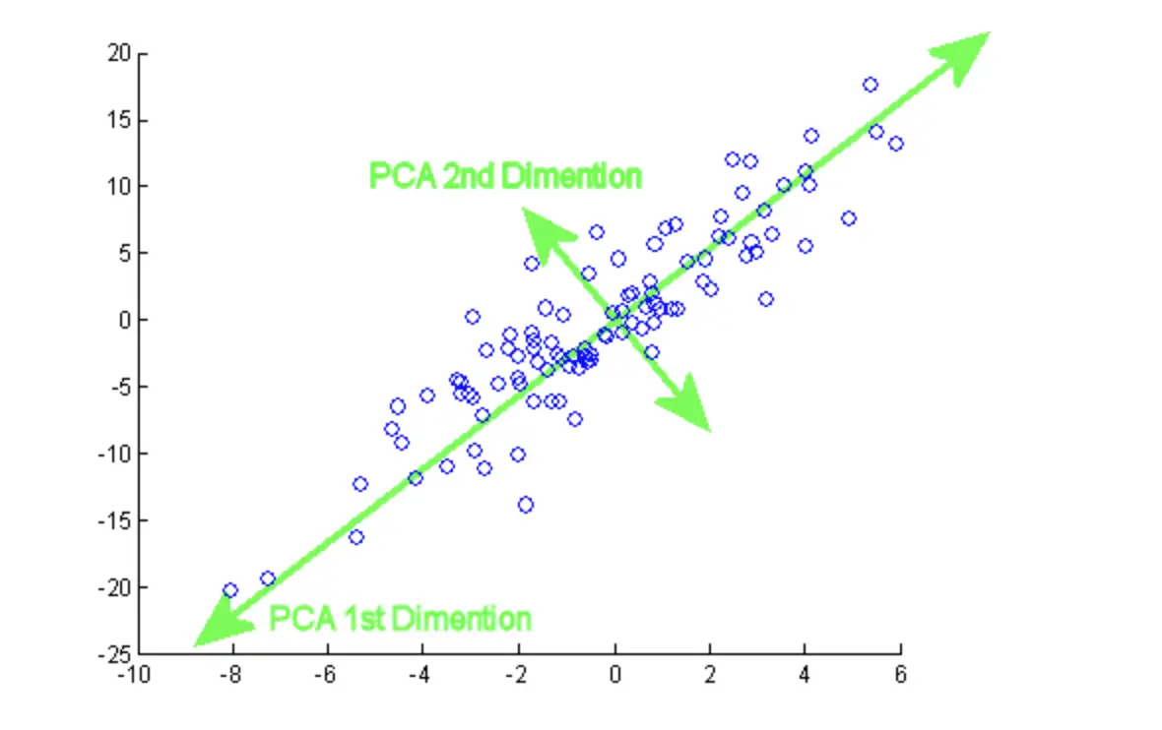
PCA vs LDA?
Principal Component Analysis is an unsupervised learning technique [1]
Used for data analysis and finding patterns
Always chooses components that maximize variance
Compress your data while retaining most of the information
Fig.7 PCA Dimensionality Reduction
http://bit.ly/3G51zqM

Slide 10
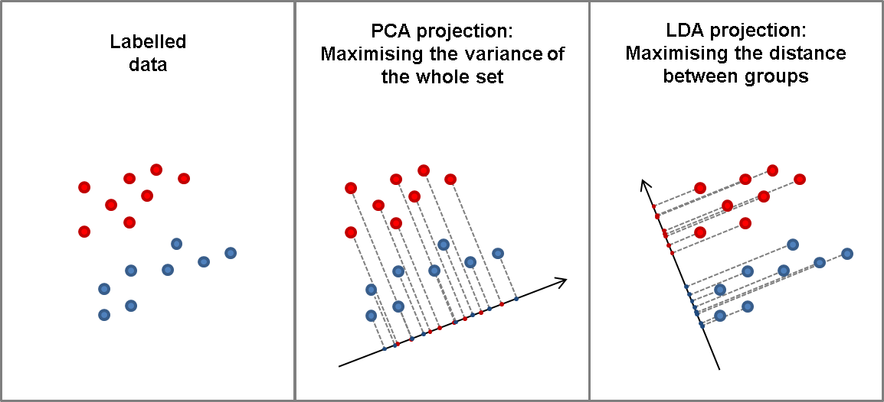
Key Differences
 | PCA | LDA
Objective | Maximize Variance | Maximize Separation
Type | Unsupervised | Supervised
Outputs | Principal components | Discriminant Functions
Use case | EDA | Classification
Fig.8 PCA Vs LDA
https://bit.ly/3G4geTh

Slide 11

Assumptions
Normality - LDA assumes that the features within each class are normally distributed [2].
Homoscedasticity – Each feature should have the same amount of variance.
Independence of Features – There should be little or no multicollinearity.
Linearity – Relation between features and class labels should be linear.

Slide 12
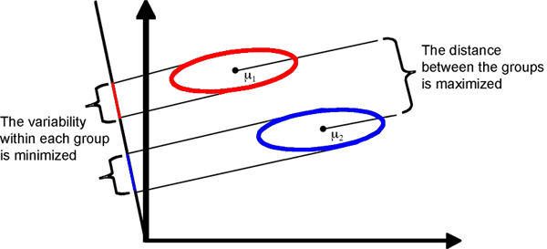
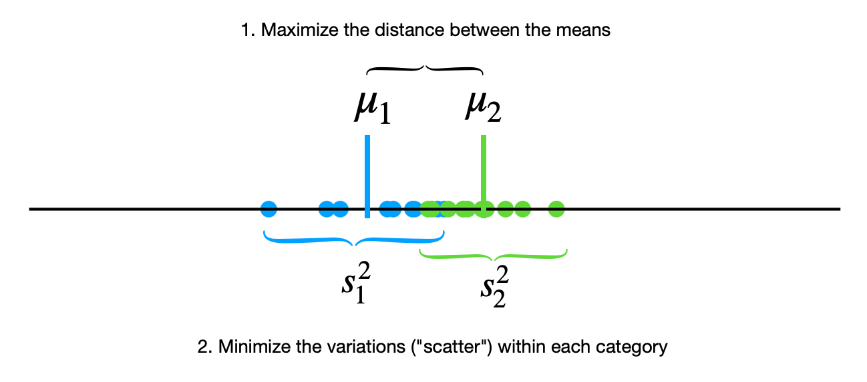
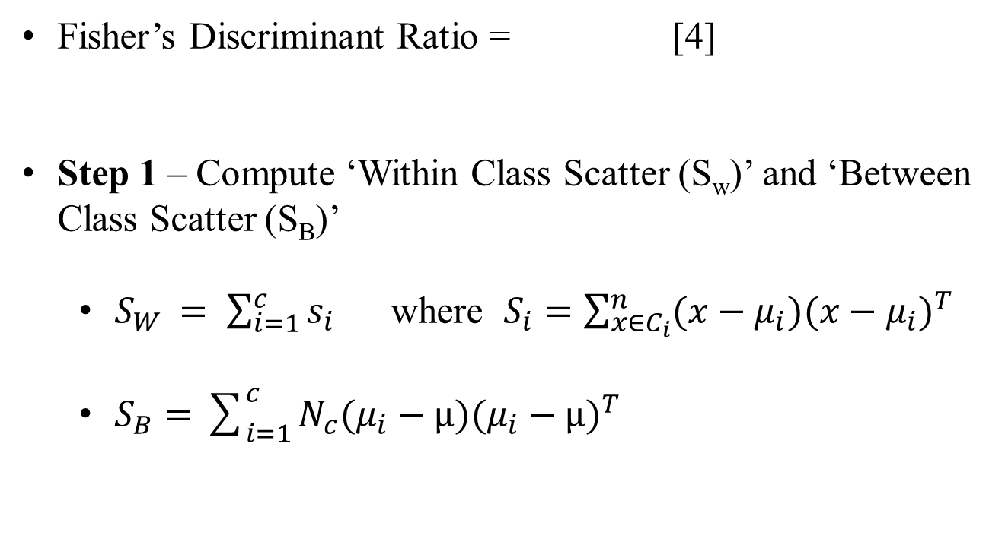
LDA Implementation
Fisher’s Discriminant Ratio = [4]
Step 1 – Compute ‘Within Class Scatter (S_{w})’ and ‘Between Class Scatter (S_{B})’
$S_{W }= \sum_{i=1}^{c}{s_{i}}$ where $S_{i}=\sum_{{x∈C}_{i}}^{n}{(x−μ_{i}){(x−μ_{i})}^{T}}$
$S_{B}=$ $\sum_{i=1}^{c}{N_{c}(μ_{i}−μ){(μ_{i}−μ)}^{T}}$
Fig.9 LDA Projection Vector
https://bit.ly/47GkNPz
Fig.10 Points projected on vector
https://bit.ly/3QK7aHV

Slide 13
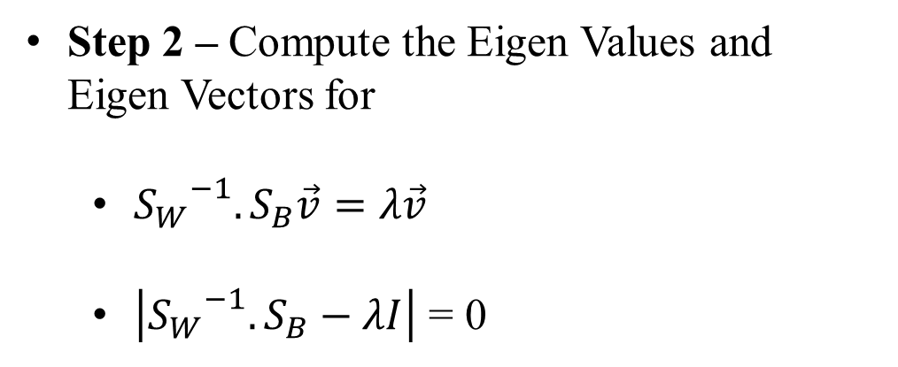
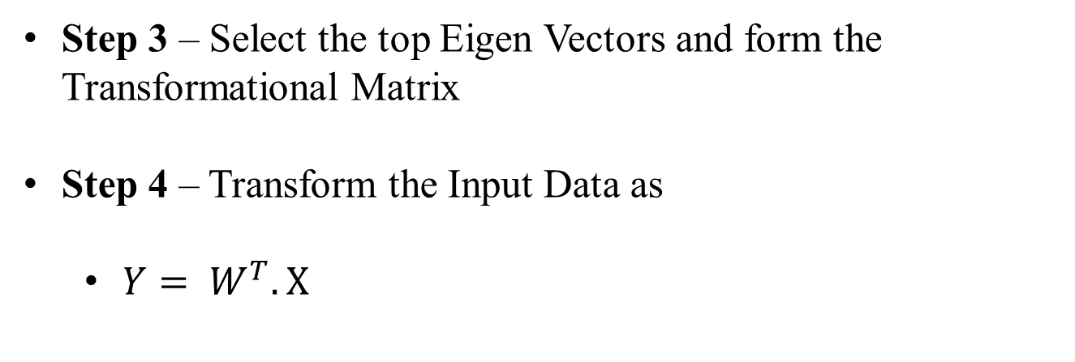
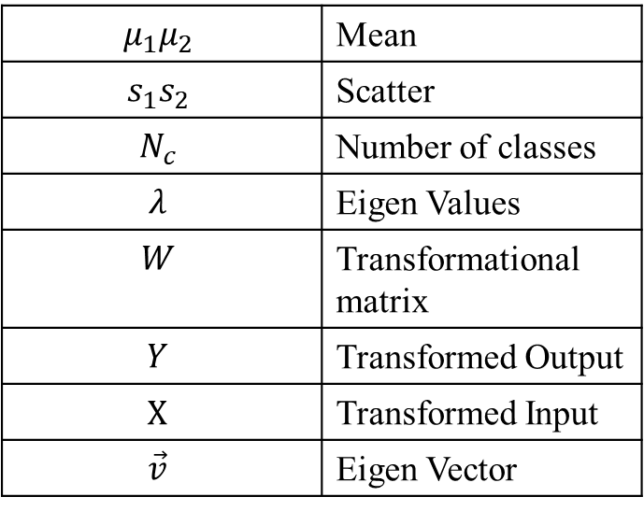
LDA Implementation
Step 2 – Compute the Eigen Values and Eigen Vectors for
${S_{W}}^{−1}.S_{B}\vec{v}=λ\vec{v}$
$\left|{S_{W}}^{−1}. S_{B}−λI\right|$ = 0
$$μ_{1}μ_{2}$$ | Mean
$$s_{1}s_{2}$$ | Scatter
$$N_{c}$$ | Number of classes
$$λ$$ | Eigen Values
$$W$$ | Transformational matrix
$$Y$$ | Transformed Output
$$X$$ | Transformed Input
$$\vec{v}$$ | Eigen Vector
Step 3 – Select the top Eigen Vectors and form the Transformational Matrix
Step 4 – Transform the Input Data as
$Y= W^{T}.X$
Table2. Variables and their Meanings.

Slide 14
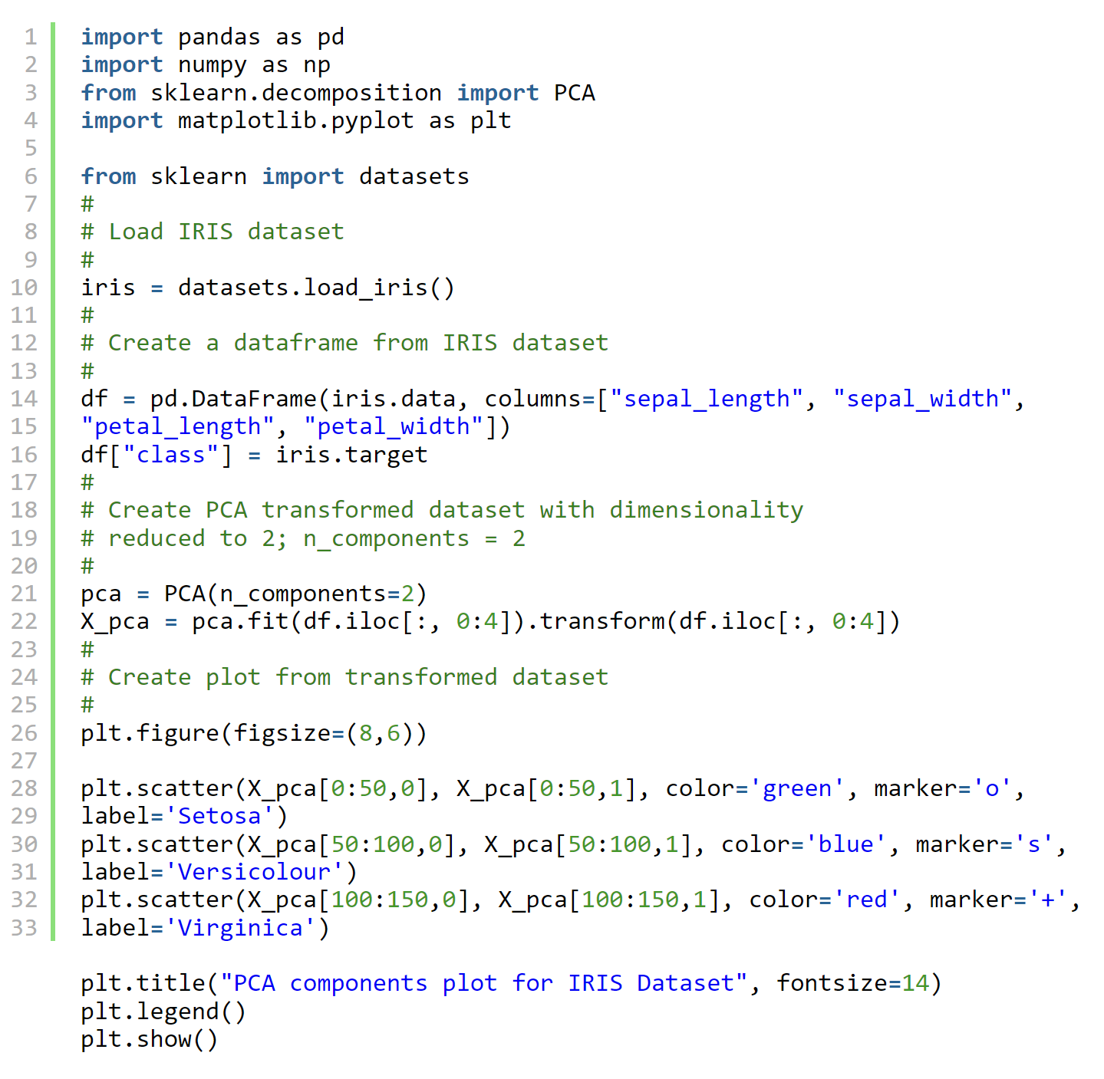
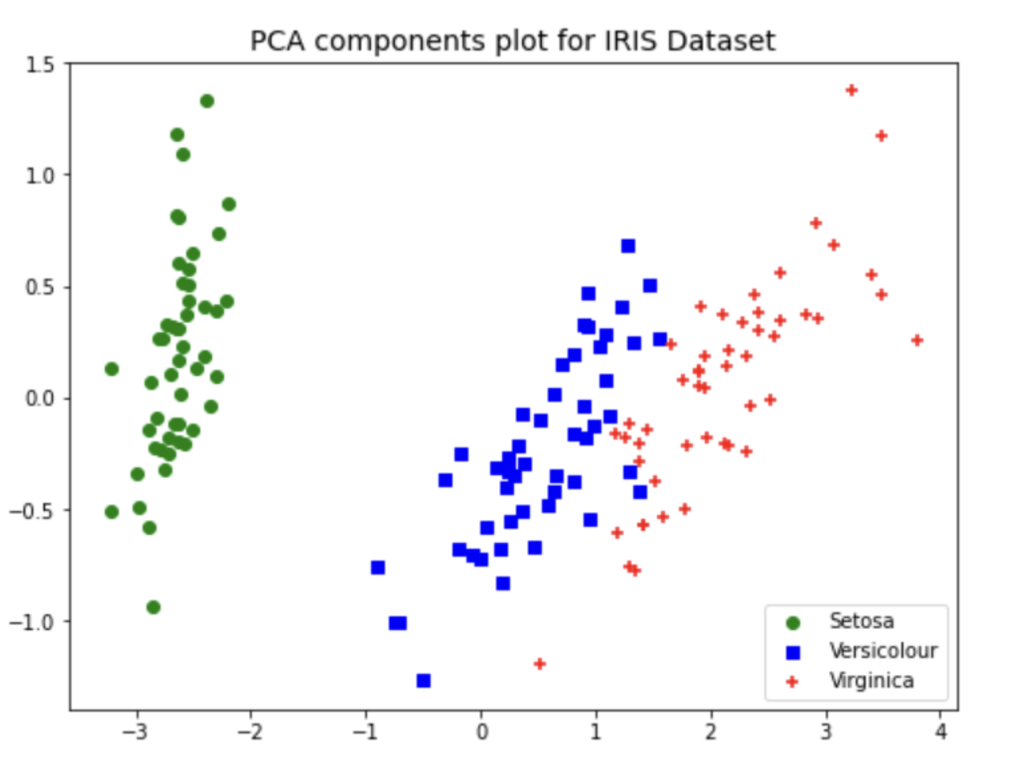
Program Implementation
Fig.11 Iris dataset plot on PCA Component Axes
https://bit.ly/47yFoVN

Slide 15
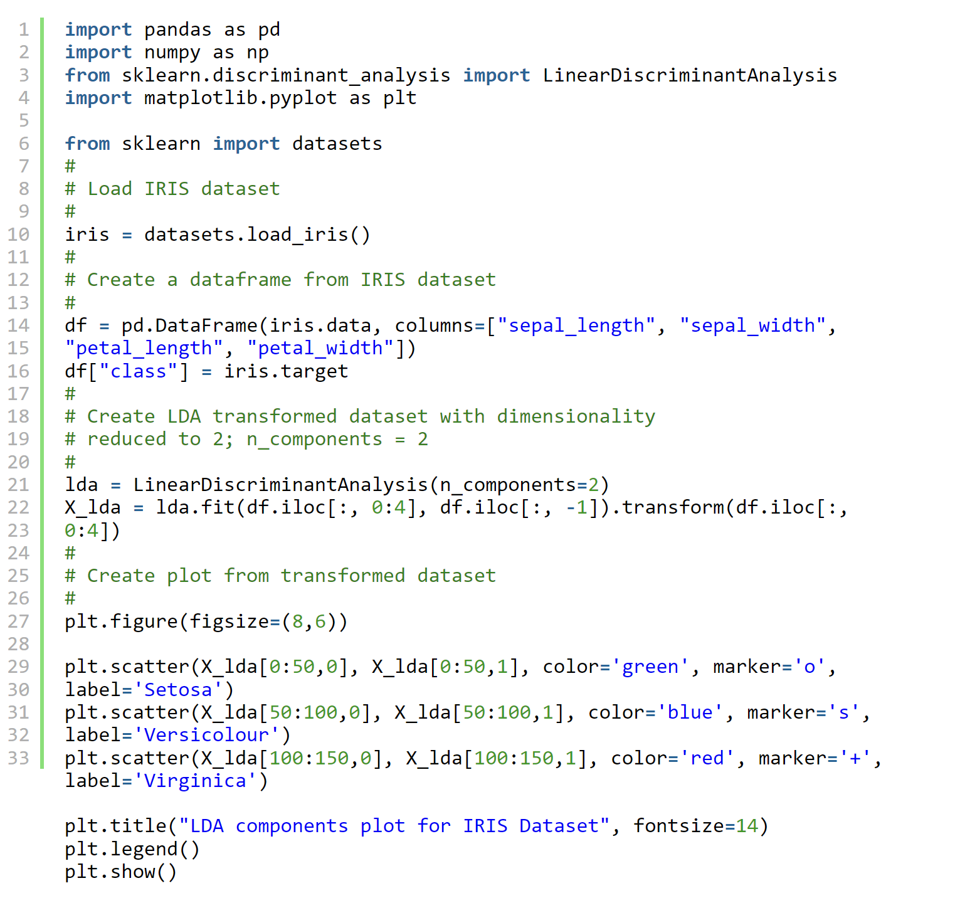
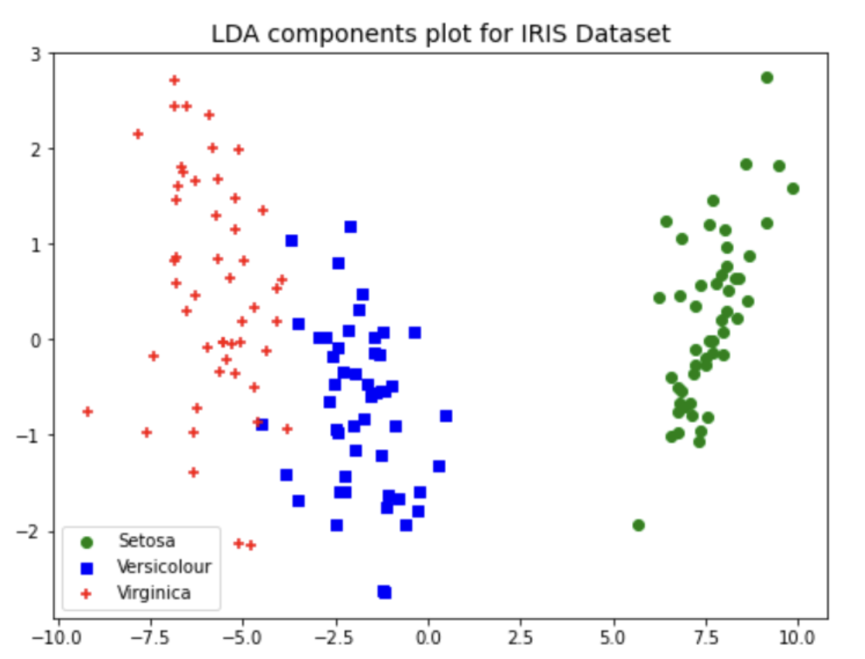
Program Implementation
Fig. 12 Iris dataset plot on LDA Component Axes
https://bit.ly/47yFoVN

Slide 16


Face recognition & Biometrics
Each face is represented as the combination of a number of pixel values.
LDA is used to minimize the number of features
Applications of LDA
To classify the patient disease(Either increase or decrease pace of treatment)
Drug suitability
Early detection of disease(EHR data)

Slide 17


Marketing and Customer Segmentation:
By classifying customers into different segments based on their purchasing behavior, demographic information, and preferences.
Applications of LDA
Remote Sensing and Image Analysis:
LDA can be used for classifying land cover types in satellite images or aerial photographs, which helps to differentiate between different types of terrain, vegetation, or land use.

Slide 18

Quality Control and Manufacturing:
Can assist in identifying defects in products by classifying items as defective or non-defective.
Useful in industries like manufacturing and production.
Applications of LDA
Document Classification:
Can categorize documents into different classes or topics.
For instance, spam and non-spam categories of E-mails or news articles into different sections.

Slide 19
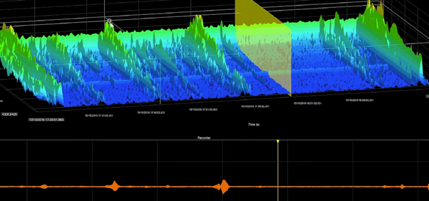
Applications of LDA
Pattern Recognition:
Where the goal is to recognize recurring patterns or structures in data.
This can be applied in various domains, including biology and signal processing.

Slide 20
Advantages and limitations of LDA
Advantages
Limitations
Sensitive to Class Distribution(Gaussian distribution).
Prone to Overfitting(Curse of dimensionality).
Doesn’t Handle Nonlinear Relationships.
Requires Well-Defined Classes(supervised technique and relies on class labels for training).
Doesn’t Incorporate Feature Interaction.
May Not Capture Complex Patterns(Non liner or neural networks).
Dimensionality Reduction with Class Separation-Simple and computationally efficient algorithm.
Utilizes Class Information
Works Well for the number of features >> the number of training samples.
Data Visualization
Robust to Outliers due to its reliance on class means and variances rather than individual data points.

Slide 21
Extensions to LDA
Non-linear Discriminant analysis
Quadratic Discriminant Analysis (QDA): Each class uses its own estimate of variance (or covariance when there are multiple input variables).
Flexible Discriminant Analysis (FDA): Where non-linear combinations of inputs are used such as splines.
Regularized Discriminant Analysis (RDA): Introduces regularization into the estimate of the variance (actually covariance), moderating the influence of different variables on LDA.

Slide 22
Conclusion
-LDA fails to create new axes which seperates 2 class linearly, in cases where mean of distribution is shared
-LDA
supervised learning
Aims to find LD to represent axes that maximize separation between different classes of data
-PCA
unsupervised learning
-Aims to find PC to maximize the variance
-Both are Dimensionality Reduction techniques
LDA is much more suitable for multi-class classification tasks compared to PCA.

Slide 23
References
[1] “Principal component analysis,” Wikipedia, https://en.wikipedia.org/wiki/Principal_component_analysis (accessed Nov. 17, 2023).
[2] “PCA vs LDA Differences, plots, examples,” Analytics Yogi, https://vitalflux.com/pca-vs-lda-differences-plots-examples/ (accessed Nov. 17, 2023).
[3] Seldon, “Supervised vs unsupervised learning explained,” Seldon, https://www.seldon.io/supervised-vs-unsupervised-learning-explained#:~:text=Supervised%20machine%20learning%20is%20generally,the%20need%20for%20labelled%20data. (accessed Nov. 17, 2023).
[4] Scientific Computing and Imaging Institute, https://sci.utah.edu/~shireen/pdfs/tutorials/Elhabian_LDA09.pdf (accessed Nov. 17, 2023).
1

Slide 24
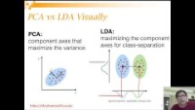
For Better Understanding
https://www.youtube.com/watch?v=D2HArUvOQaw&ab_channel=SaptarsiGoswami

Slide 25
Thank you!

